Slide 1
PMS Node.js Stream Application
14th March 2014 / Qiang Tang

Slide 2
Node.js
Node.js is a platform built on Chrome's JavaScript runtime for easily building fast, scalable network applications. Node.js uses an event-driven, non-blocking I/O model that makes it lightweight and efficient, perfect for data-intensive real-time applications that run across distributed devices.

Slide 3
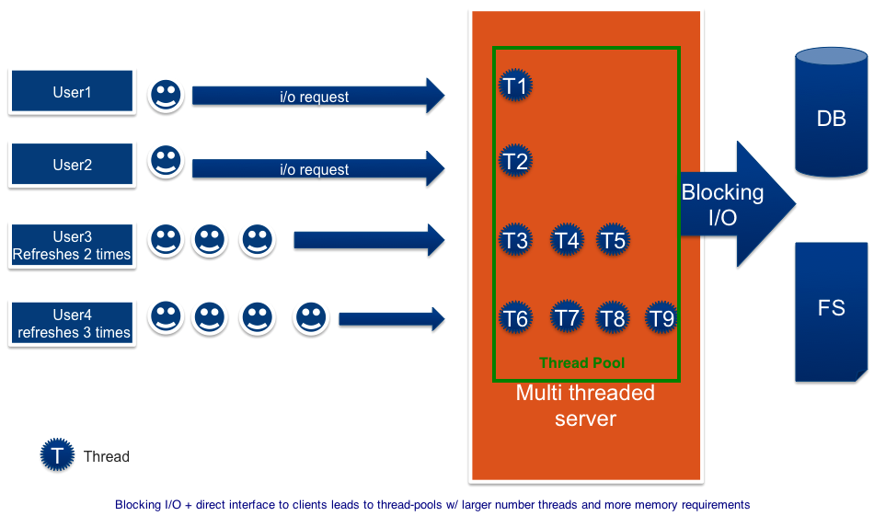
multi-threaded server

Slide 4
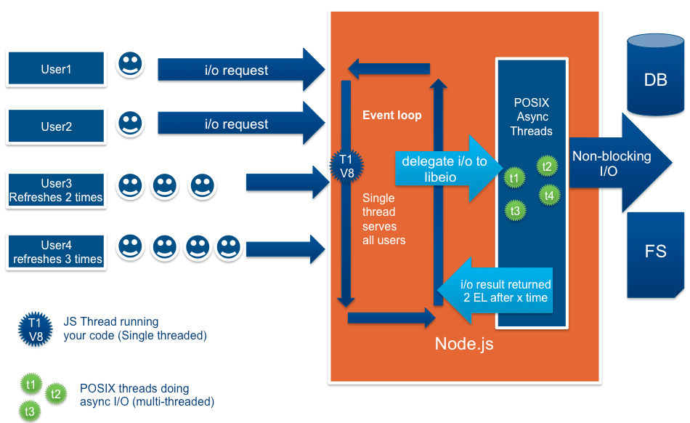
Node.js server

Slide 5


ASP.Net request
Request
Response

Slide 6
Node.js & Socket.io request
Subscribe
Pulish
Pulish
Pulish
Pulish

Slide 7
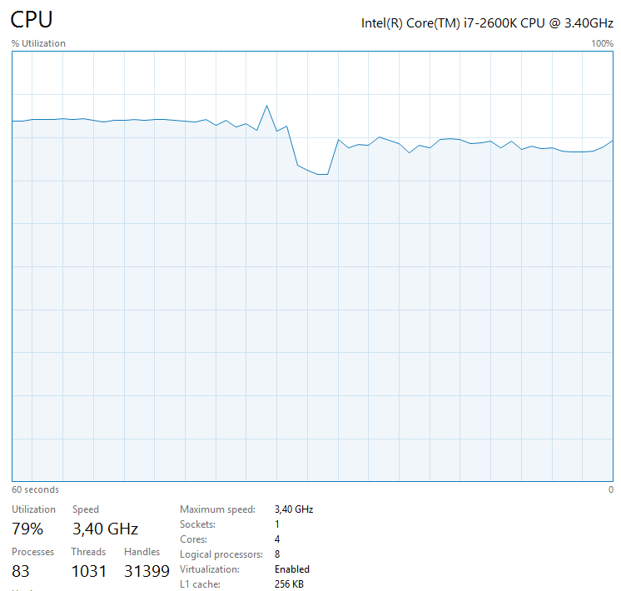
ASP.NET Web API-server:

Slide 8
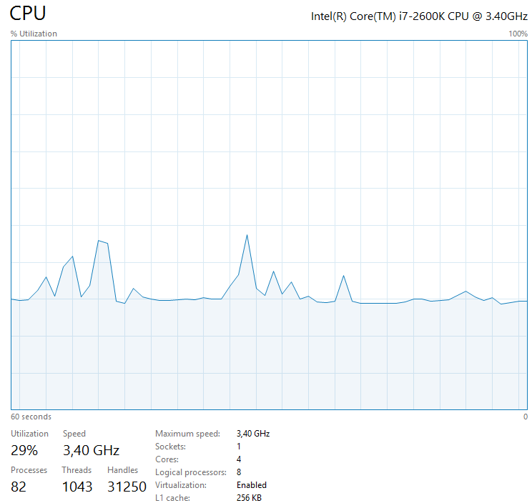
Node.js CPU usage

Slide 9


Architecture
C# .Net library
Node.js server
C / C++ library
Socket.io
Cloud
REST/SOAP
server

Slide 10
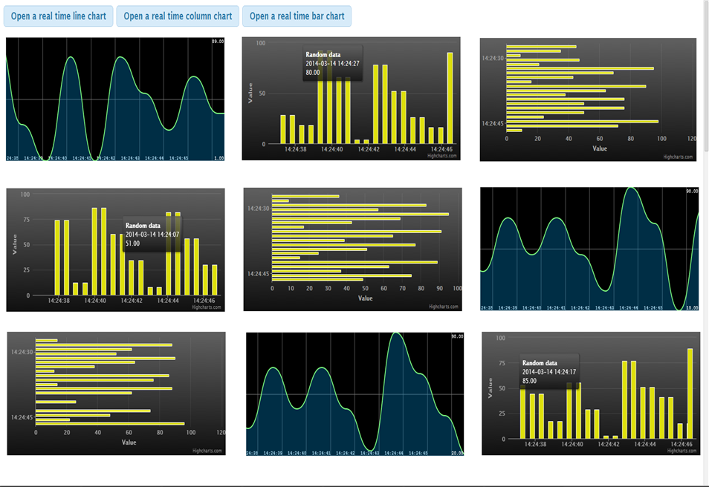
Screen shoot

Slide 11
PMS application
Visualize live P&L
Visualize live security price
Any real-time date which is sent to client

